Slide 1
CHALLENGES
AND
OPPORTUNITIES
IN
SOCIAL ENTERPRISE
CHIJMAN GURUNG

Slide 3
SUKHAWATI STORE
Non Profit Organization
“Sharing Happiness”

Slide 4
SUKHAWATI (Meaning)
“Land of bliss”

Slide 5
ABOUT US
ABOUT US

Slide 6
We work for 3p’s
PLANET
PROFIT
PEOPLE

Slide 7
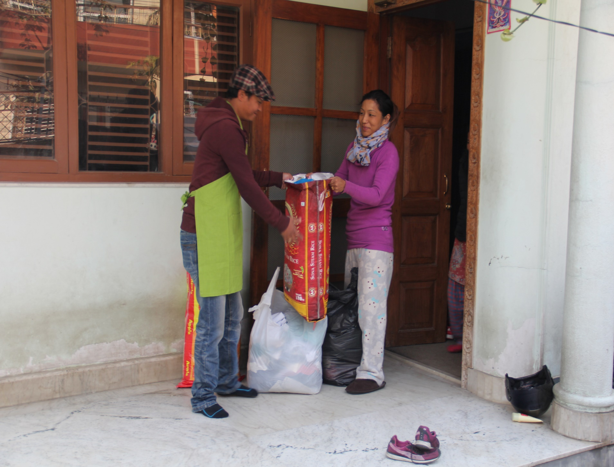
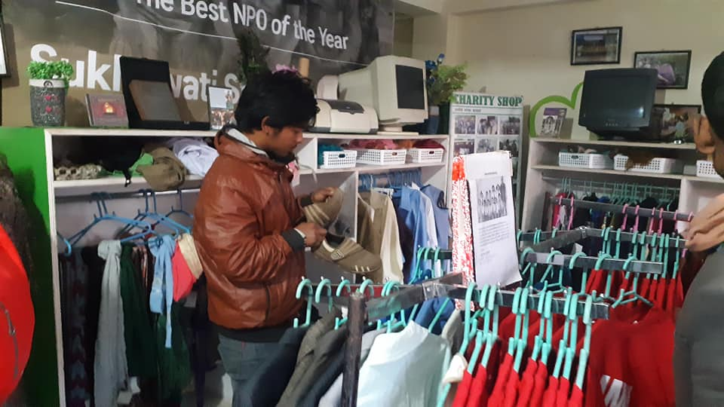
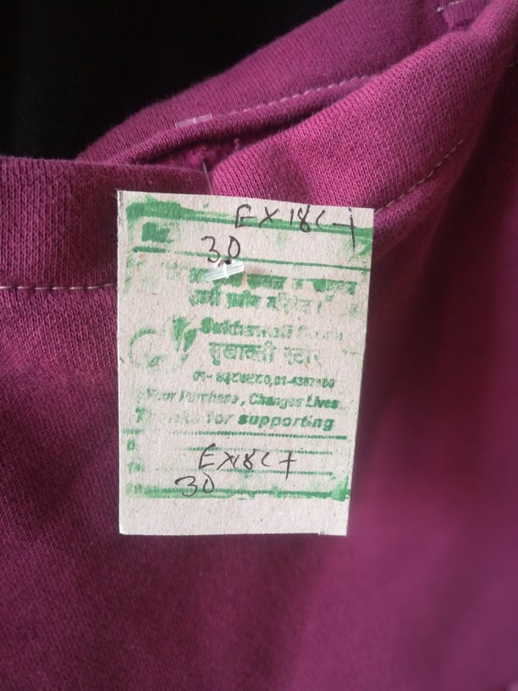
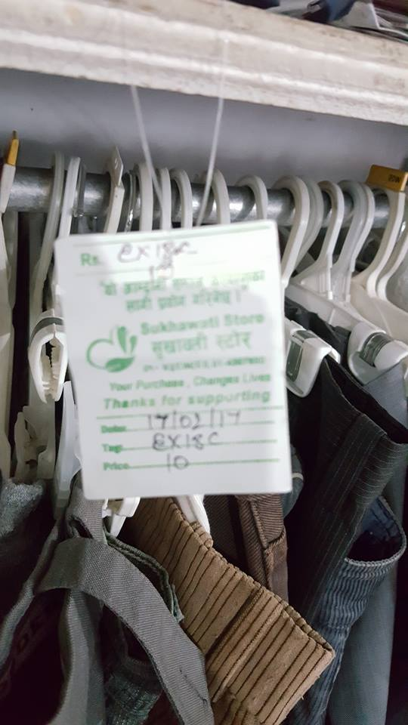
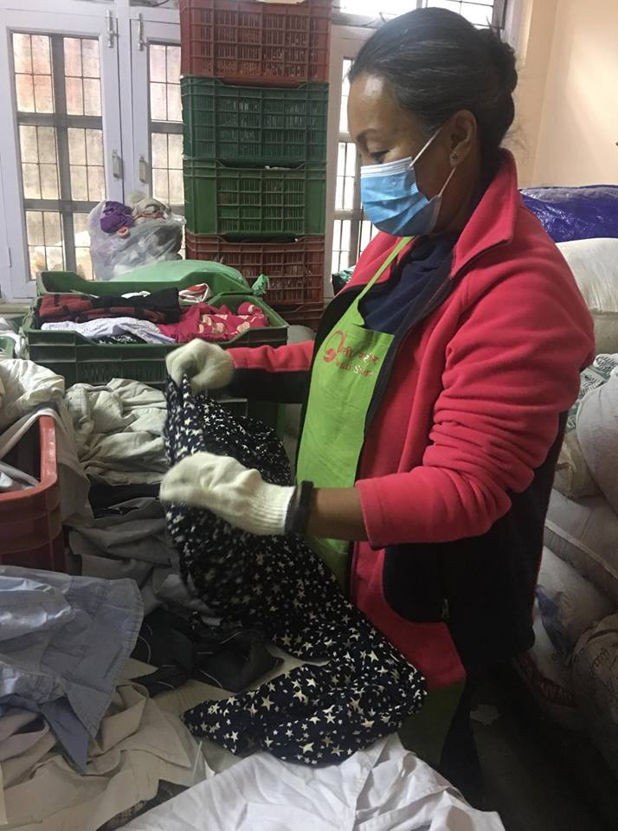
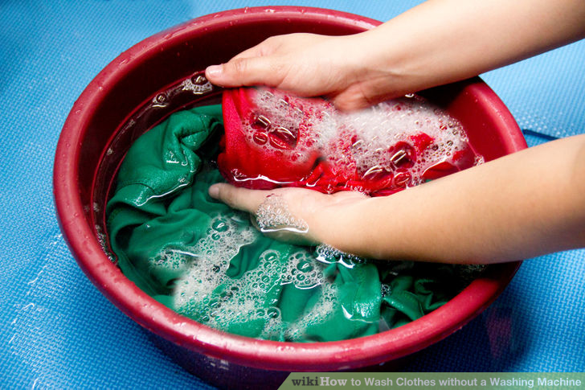
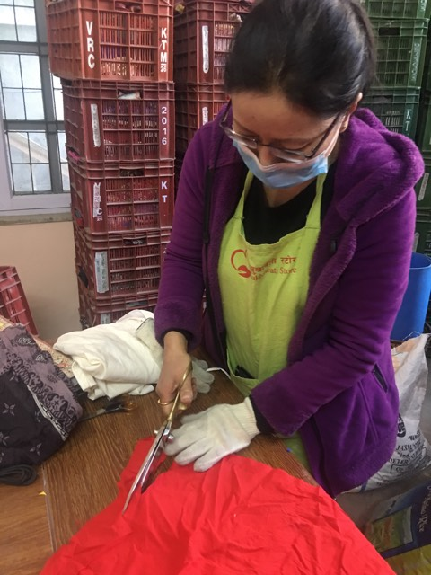
Business Model
Displaying and sales
Donation collection
Tagging
Processing
Shorting

Slide 8
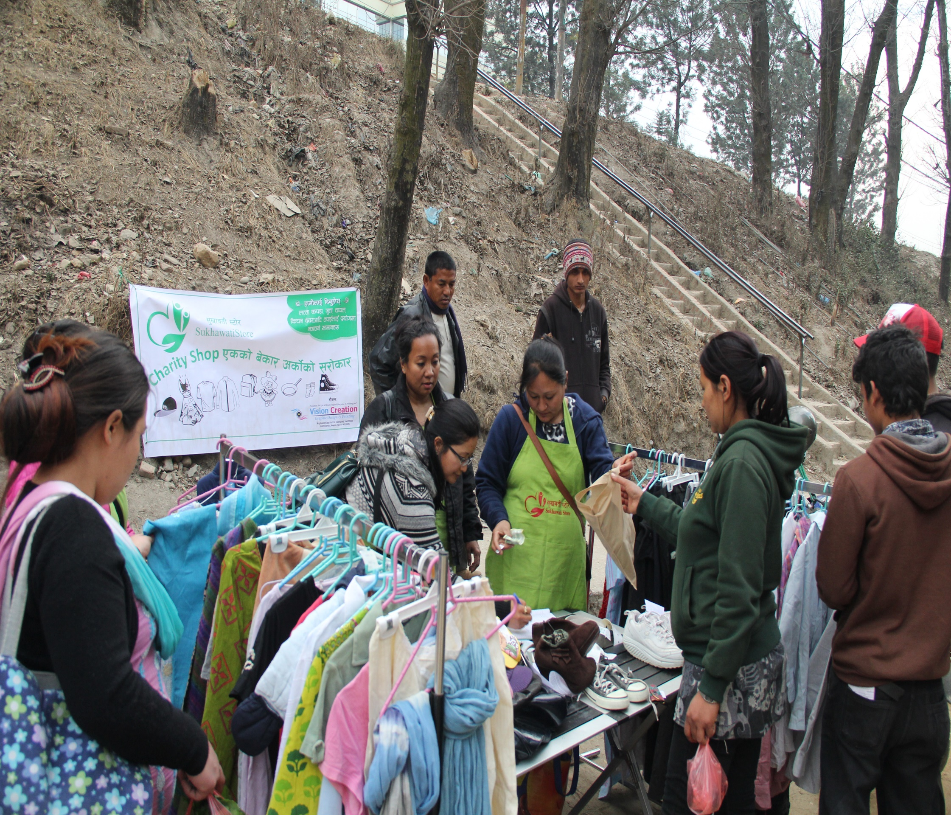
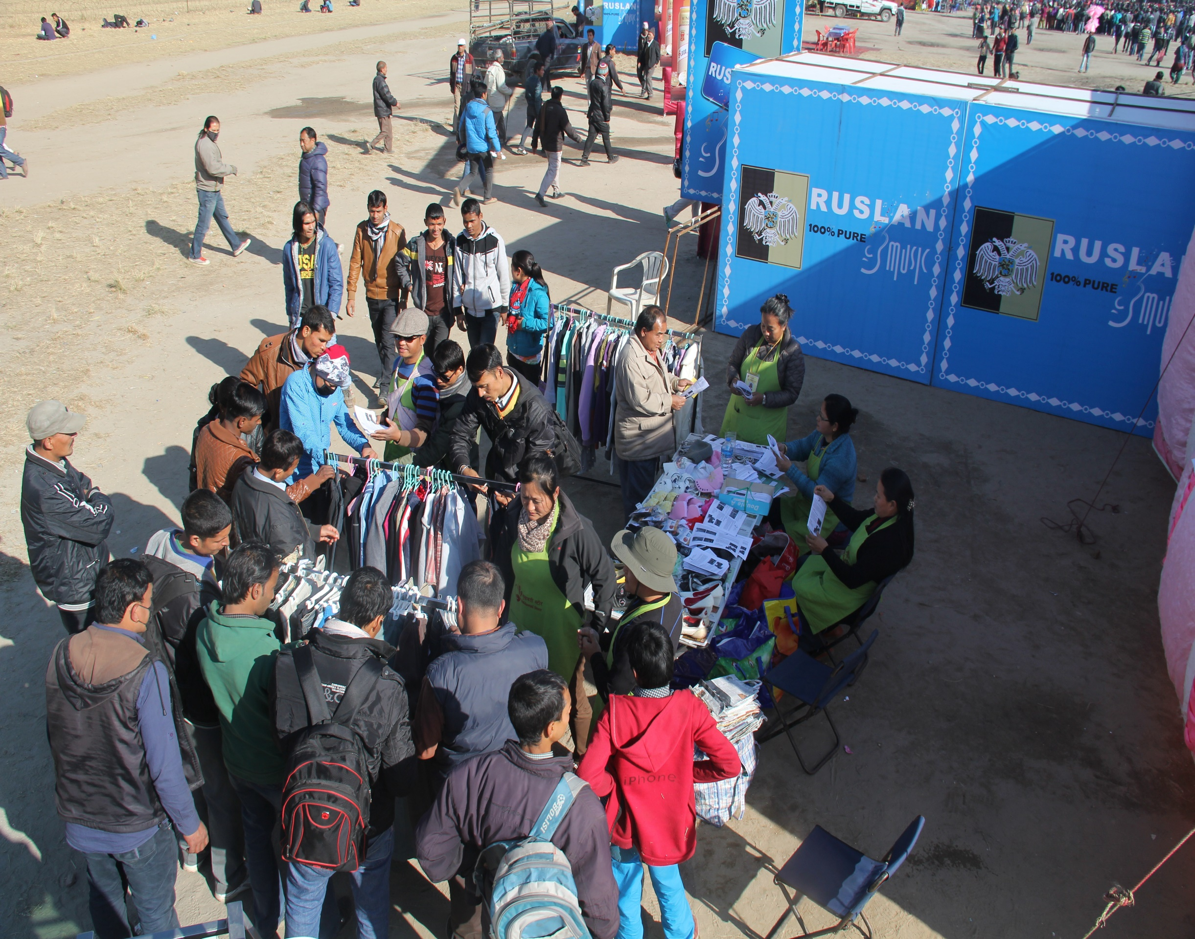
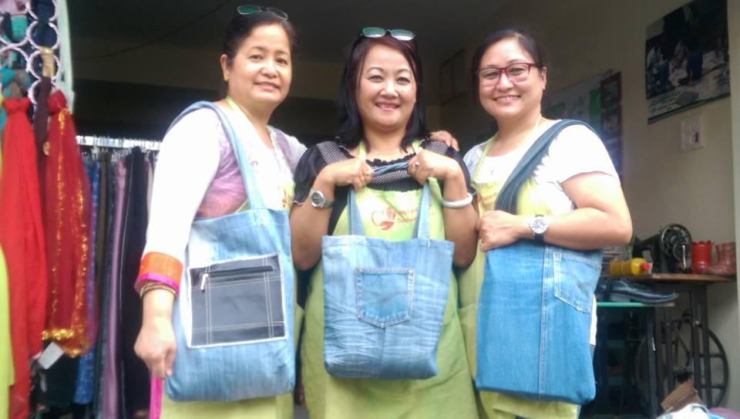
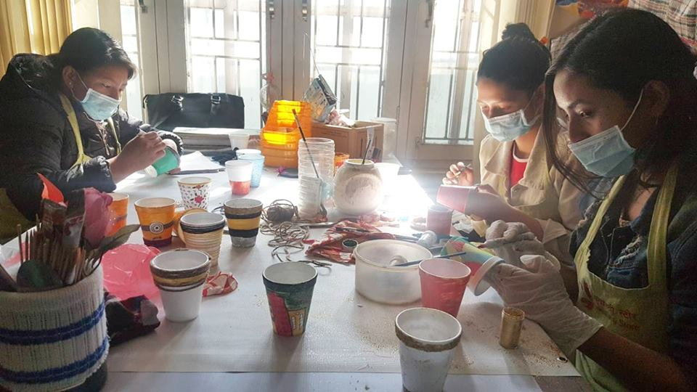
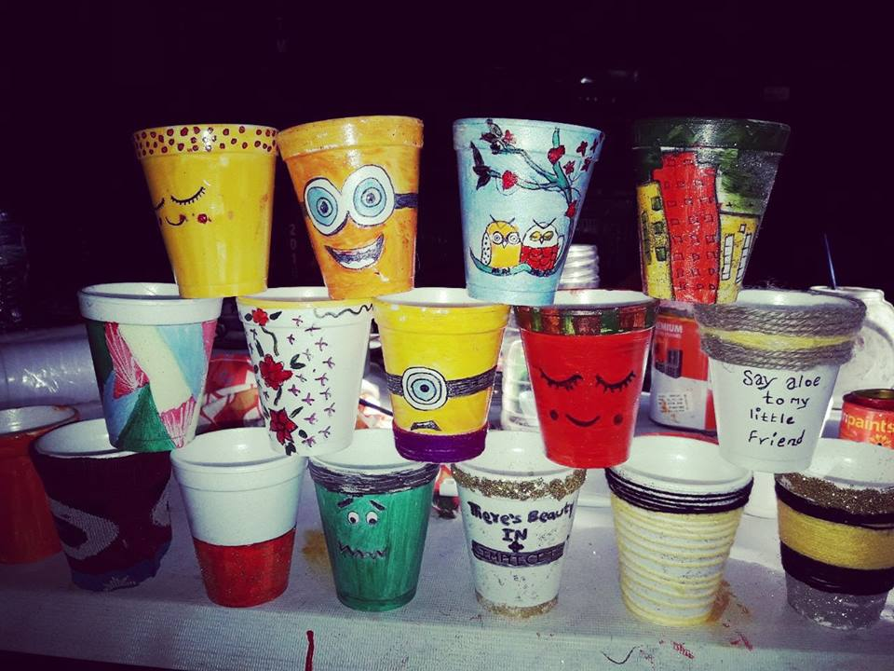
Our fundraising methods

Slide 9
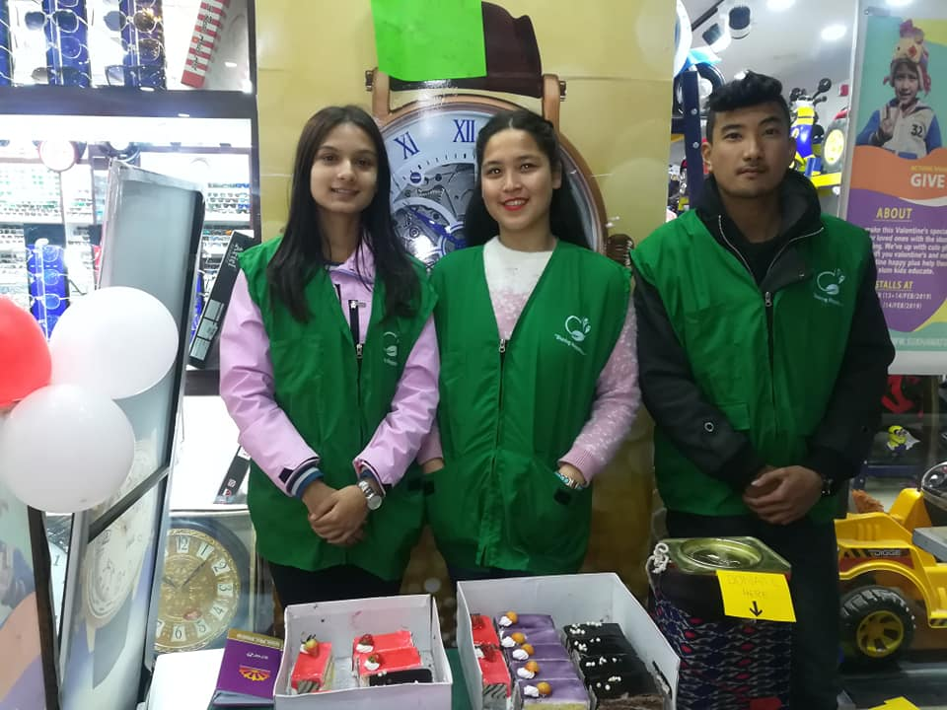
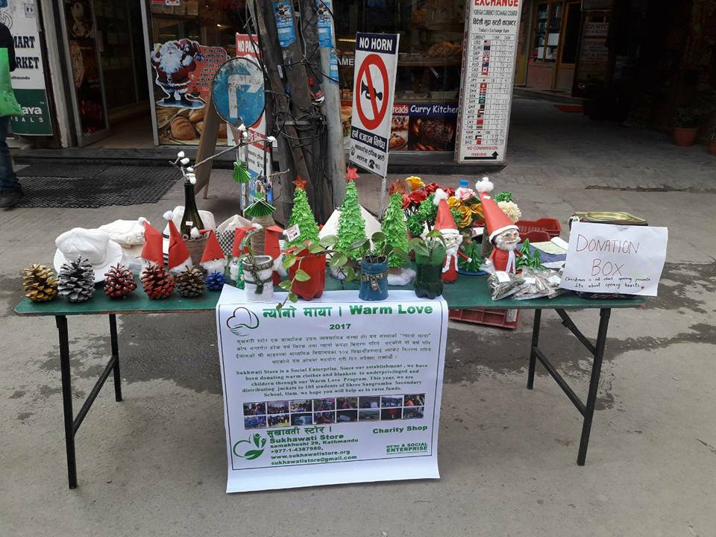
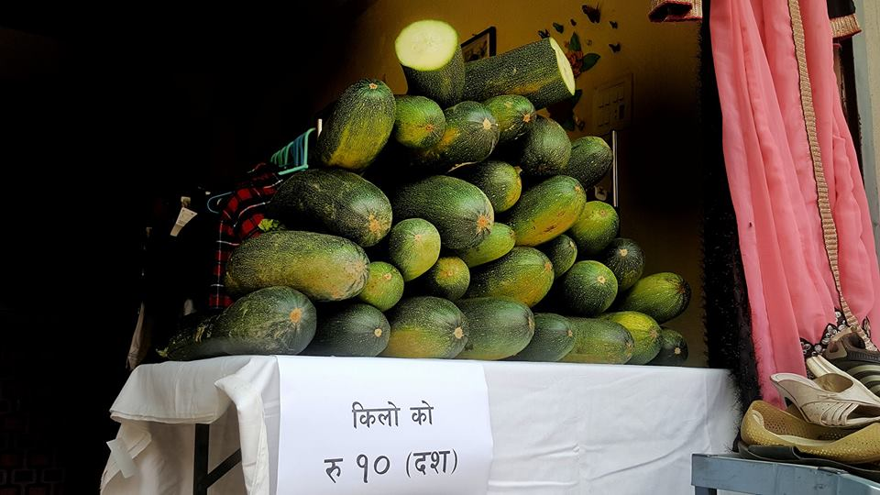
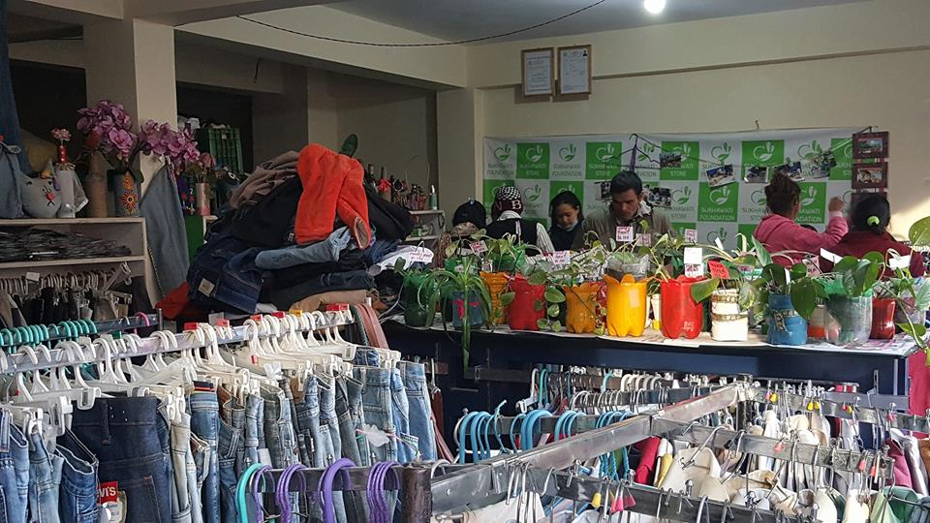
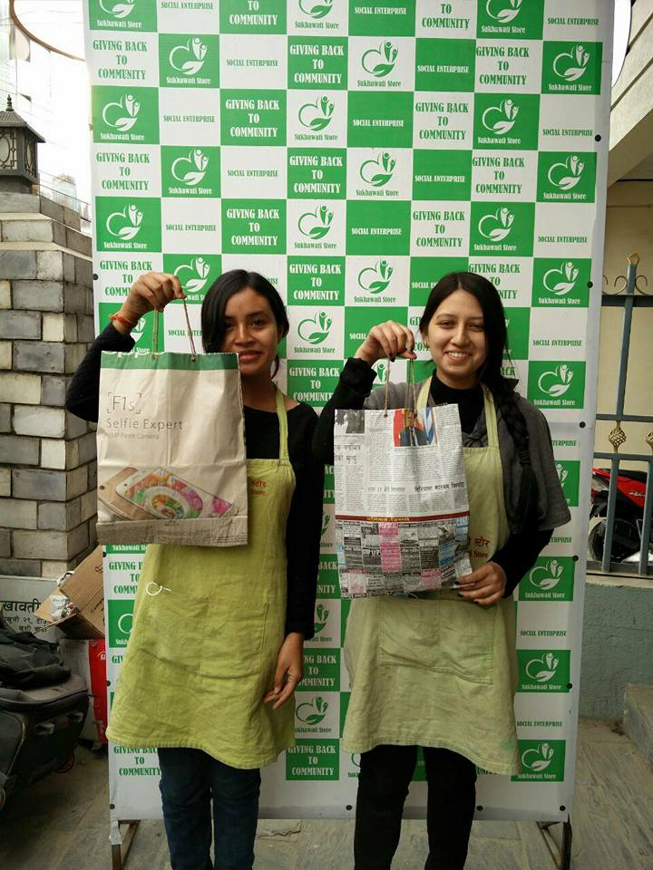
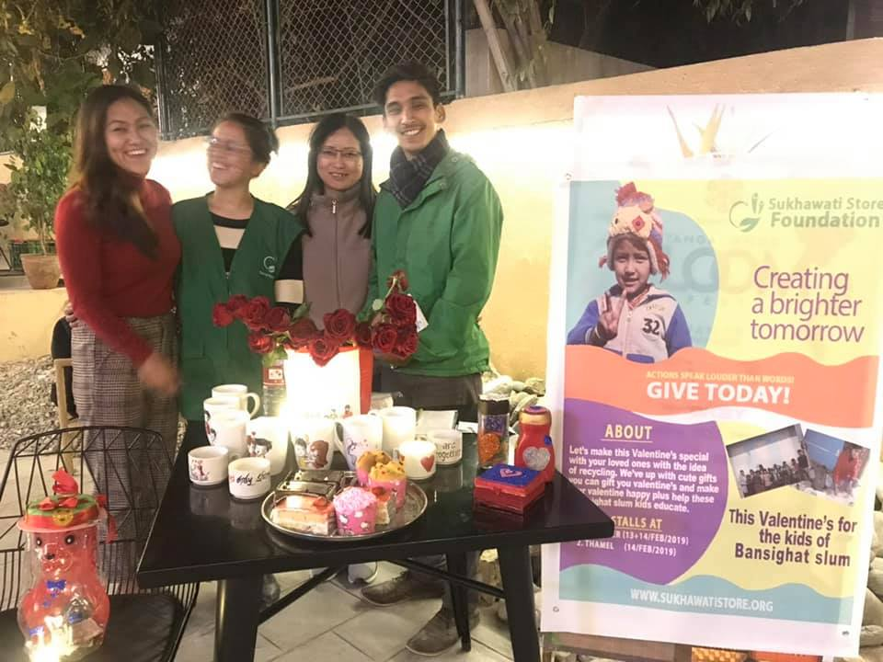
Our fundraising methods

Slide 10
Donation status
Total donation: 12751.1 kg

Slide 11
Income Expenditure status (2014 to 2018

Slide 12
Our Works
Portfolio Showcase

Slide 13
OUR WORKS
Charitable Activity

Slide 14
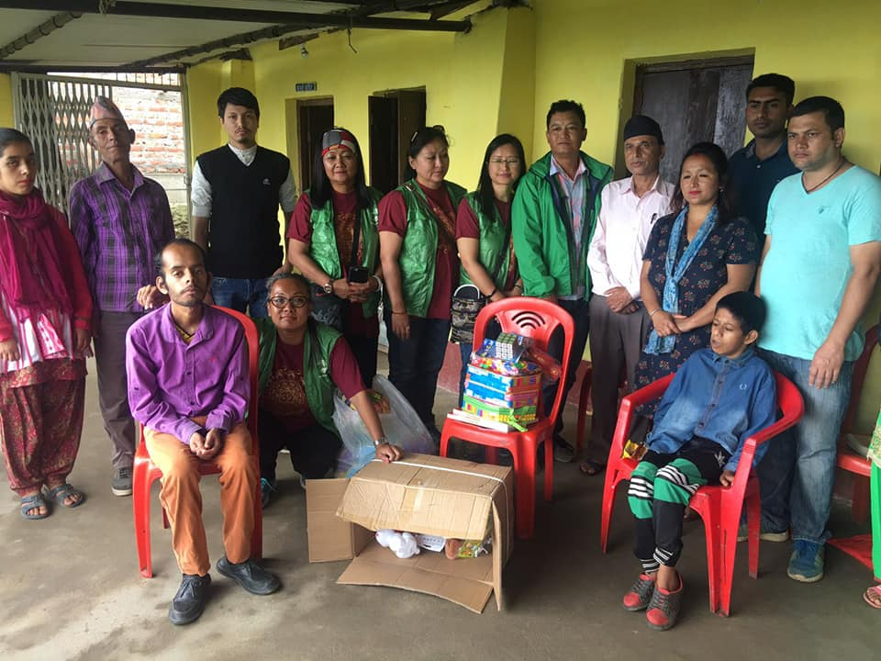
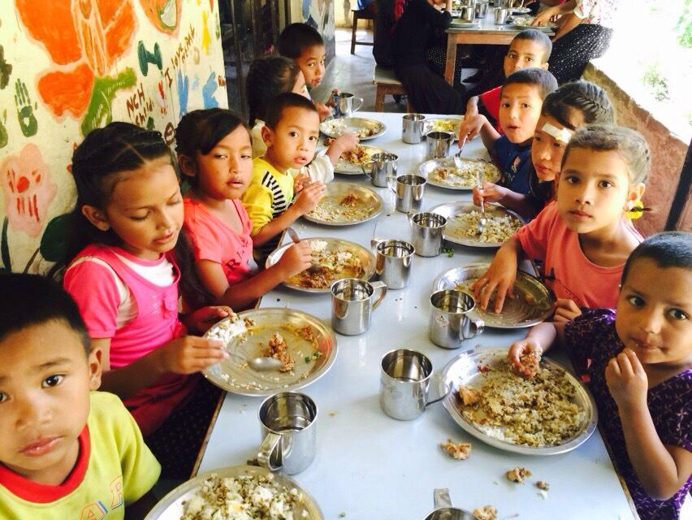
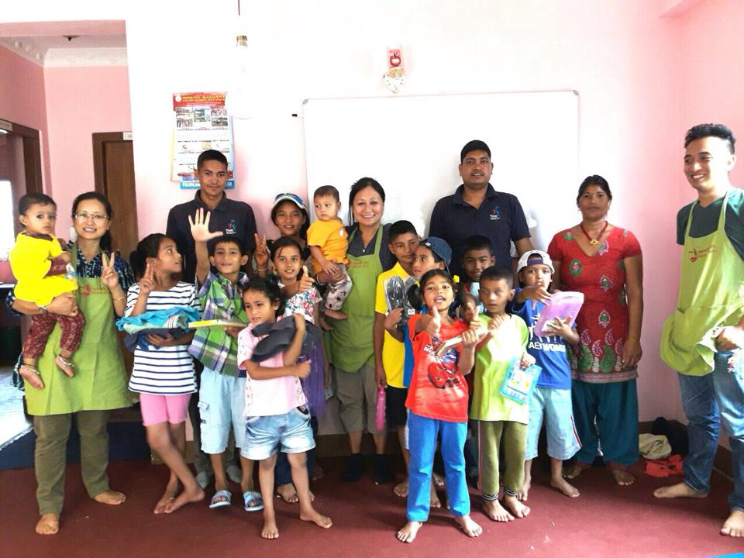
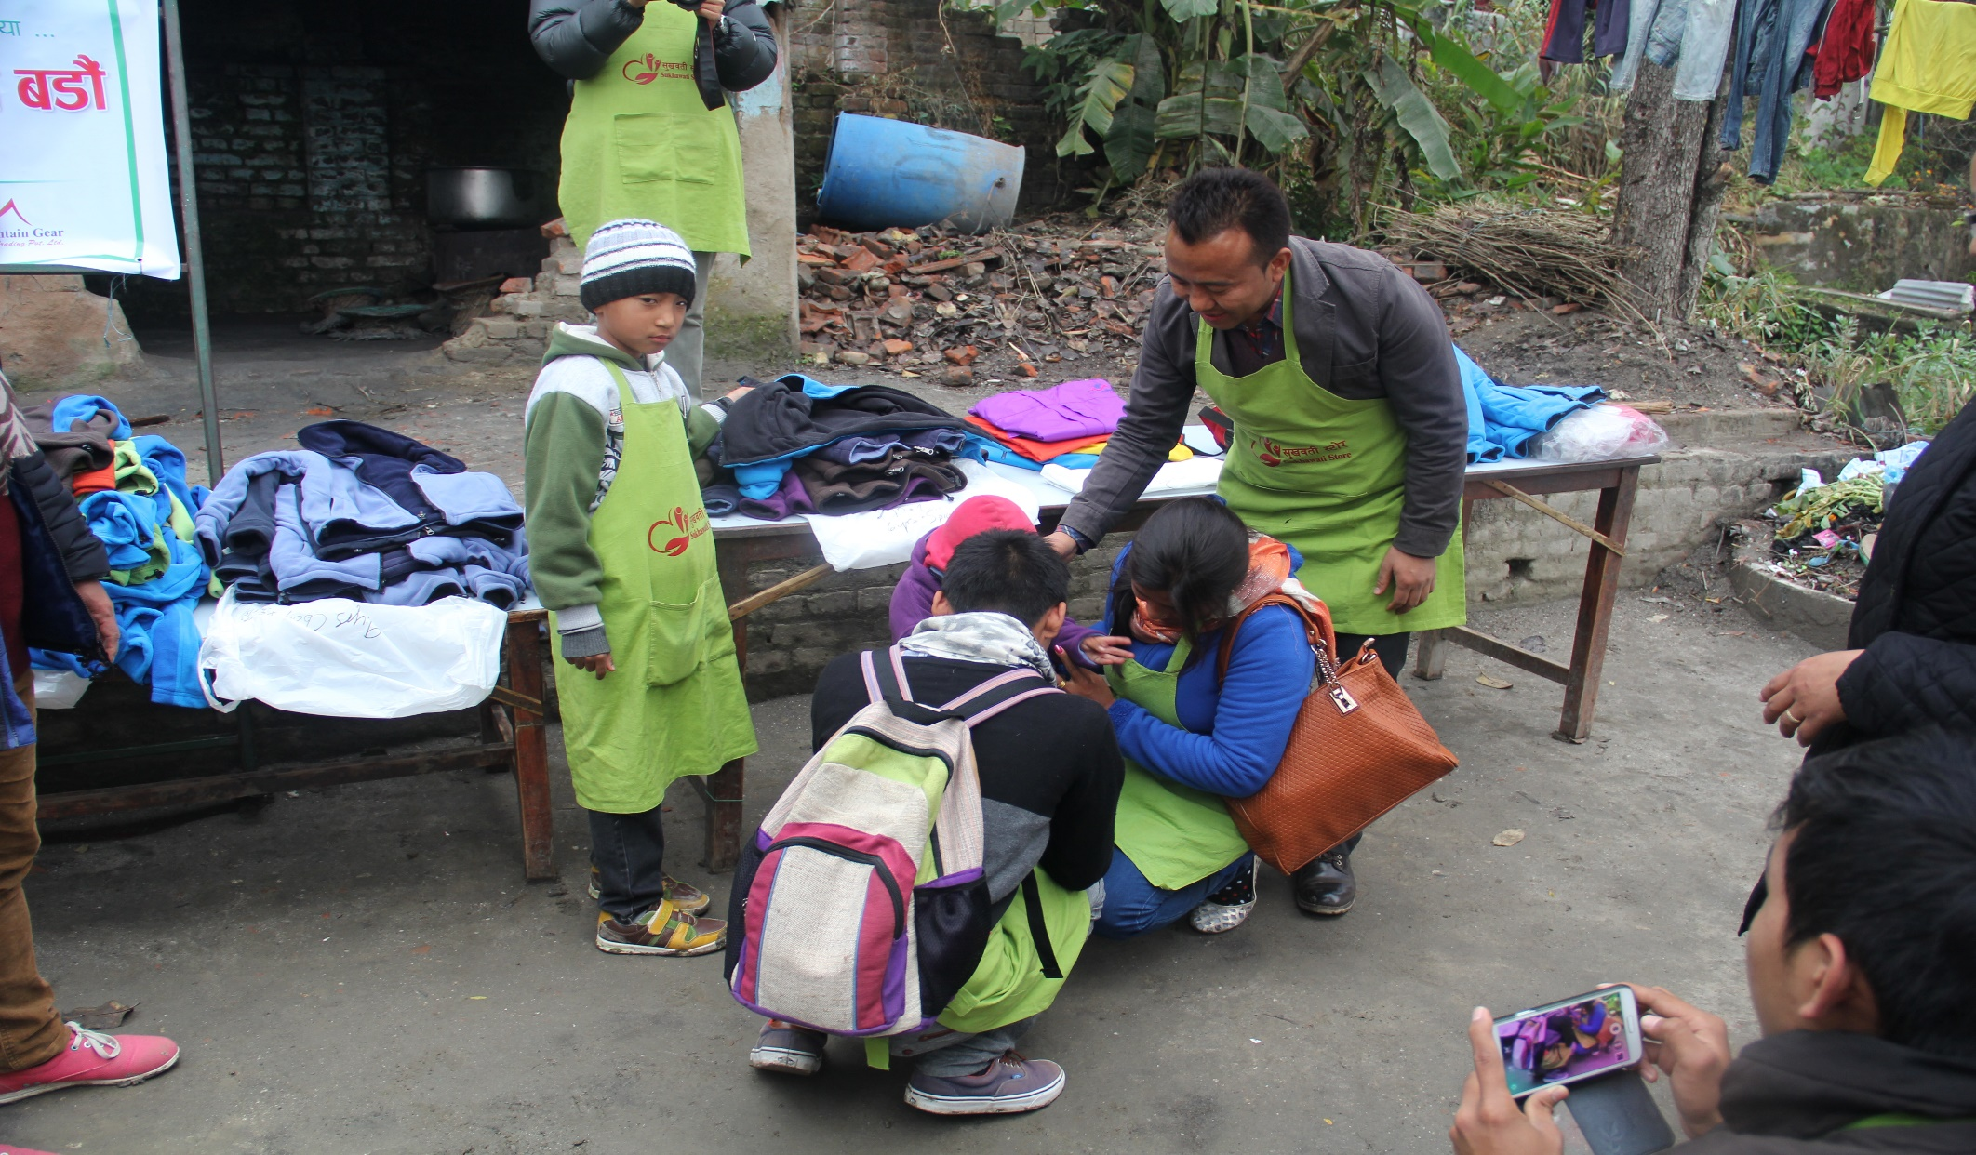
OUR WORKS
Charitable support

Slide 15
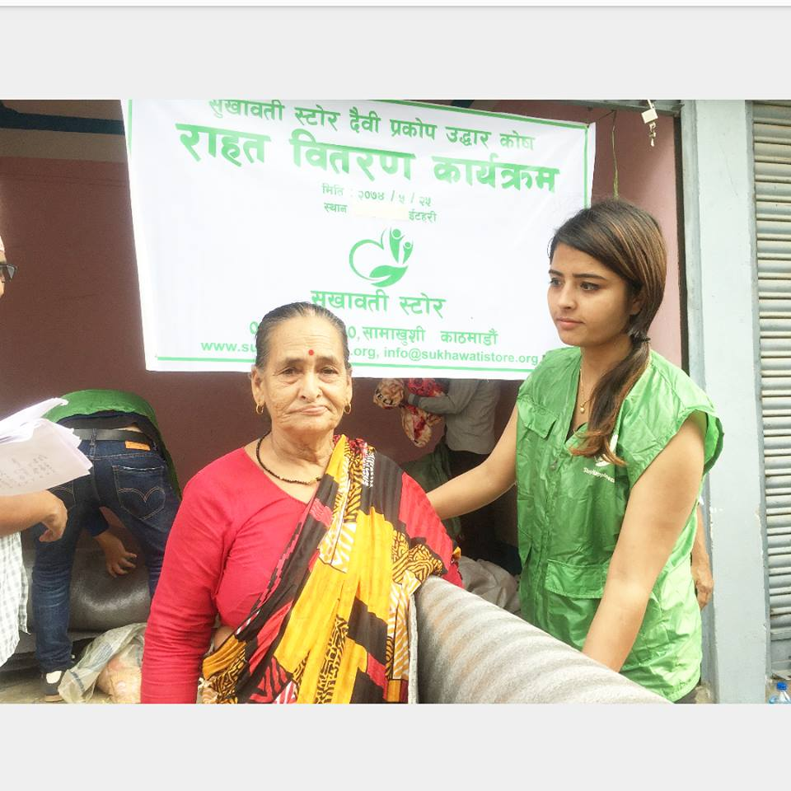
OUR WORKS
Humanitarian Relief

Slide 16
OPPORTUNITIES
SKILL DEVELOPMENT
SMALL ENTERPRENEUR GROUPS
VOLUNTEER OPPROTUNITIES
EMERGING NEW IDEAS
ENVIRONMENT

Slide 17
CHALLENGES

Slide 18
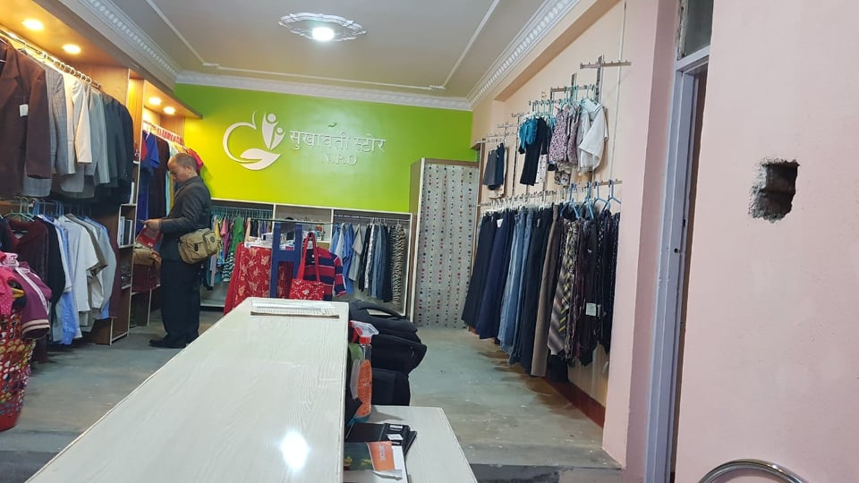
THANK YOU

